Slide 1
Module 1
General overview, Apache Spark, Environment setting

Slide 2
Module 1
About Apache Spark
Spark execution modes
Installation
Running Spark

Slide 3
On Apache Spark
Fast, expressive, general-purpose in-memory cluster computing framework compatible with Apache Hadoop and built around speed, ease of use and streaming analytics Faster and easier than Hadoop MapReduce* Large community and 3rd party libraries
Provides high-level APIs (Java, Scala, Python, R) Supports variety of workloads
interactive queries, streaming, machine learning and graph processing

Slide 4
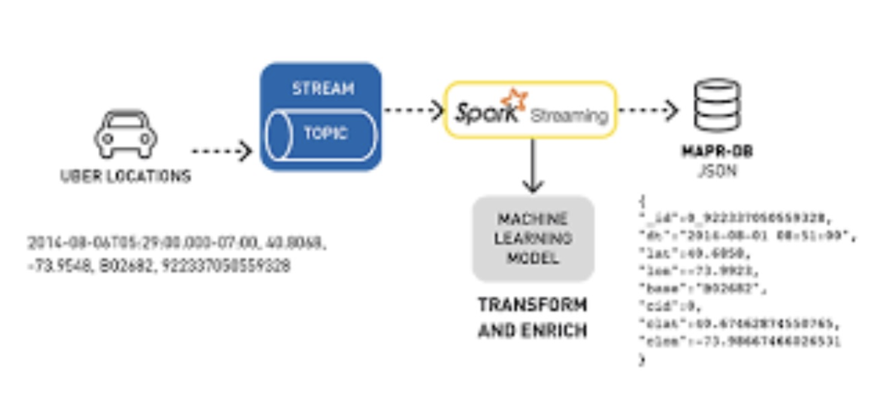
Spark Use-Cases
Logs processing (Uber)
Event detection and real-time analysis
Interactive analysis
Latency reduction
Advanced ad-targeting (Yahoo!)
Recommendation systems (Netflix, Pinterest)
Fraud detection
Sentiment analysis (Twitter)

Slide 5
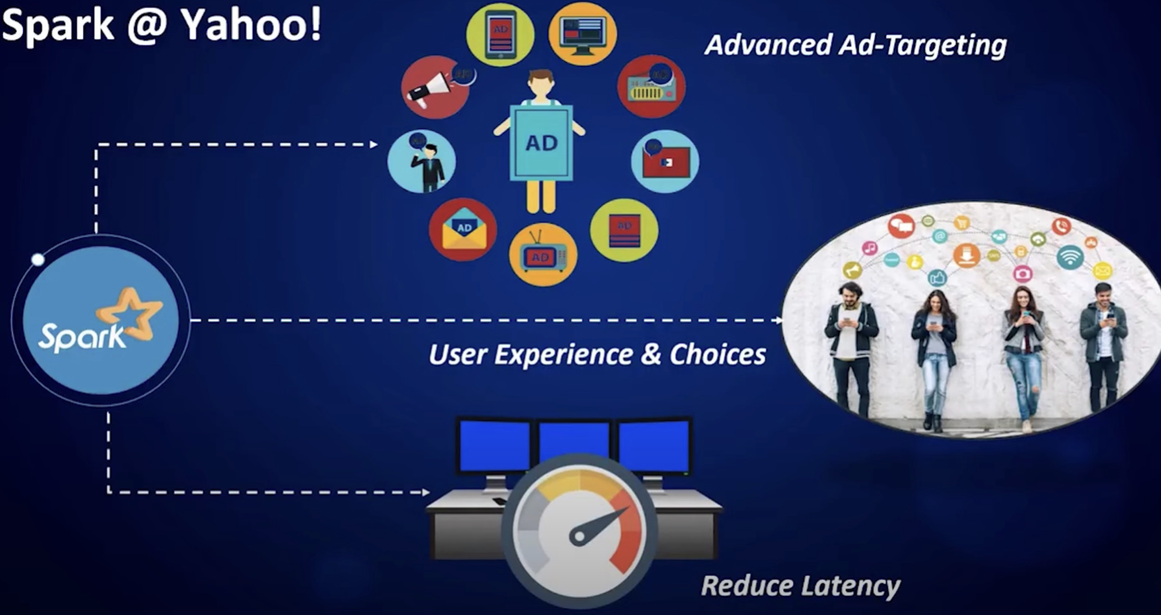
Spark Use-Cases
Logs processing (Uber)
Event detection and real-time analysis
Advanced ad-targeting (Yahoo!)

Slide 6
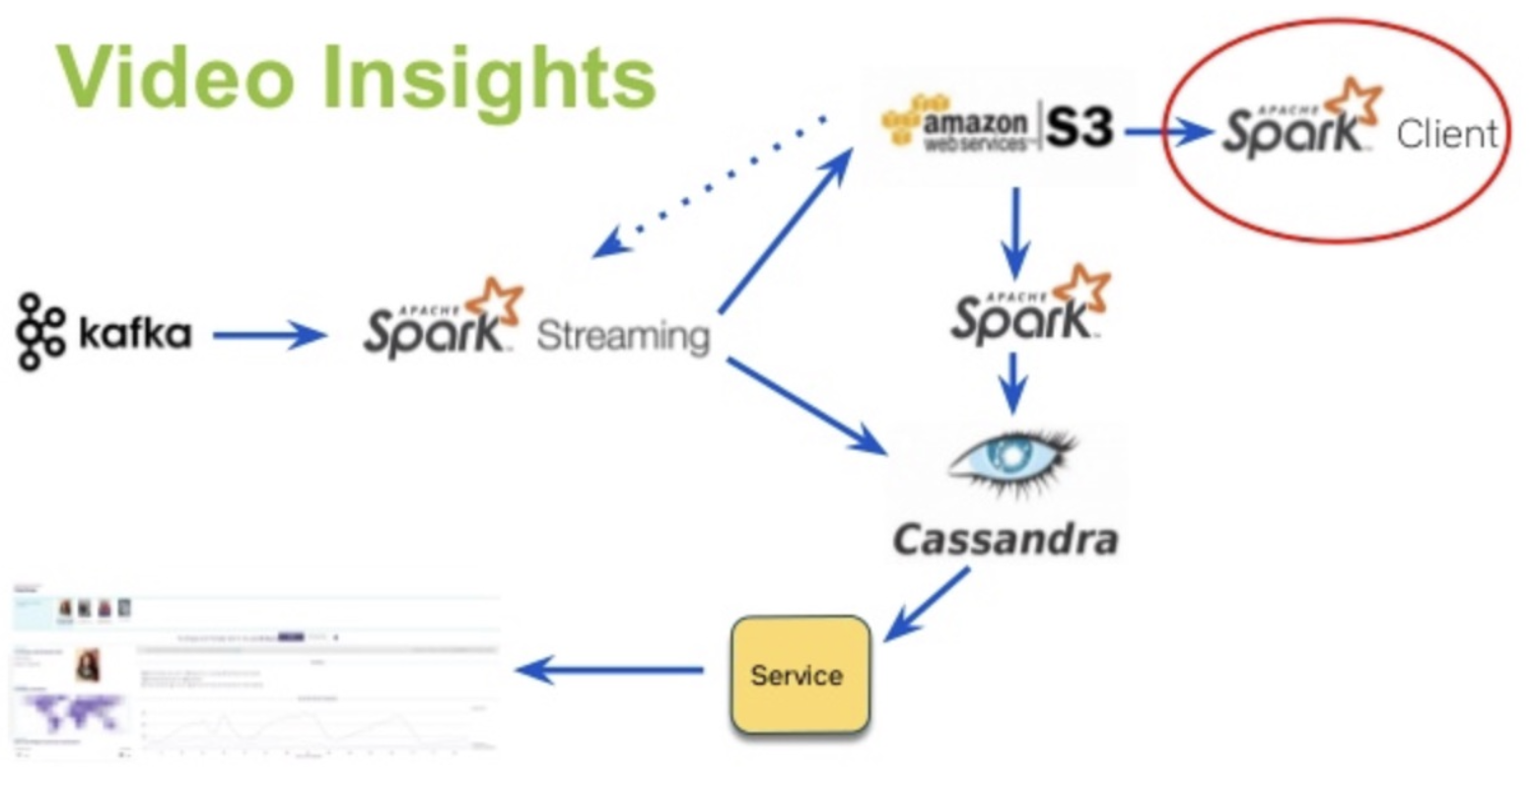
Spark Use-Cases
Logs processing (Uber)
Event detection and real-time analysis
Interactive analysis
Latency reduction
Advanced ad-targeting (Yahoo!)
Recommendation systems (Netflix, Pinterest)
Fraud detection
Sentiment analysis (Twitter)

Slide 7
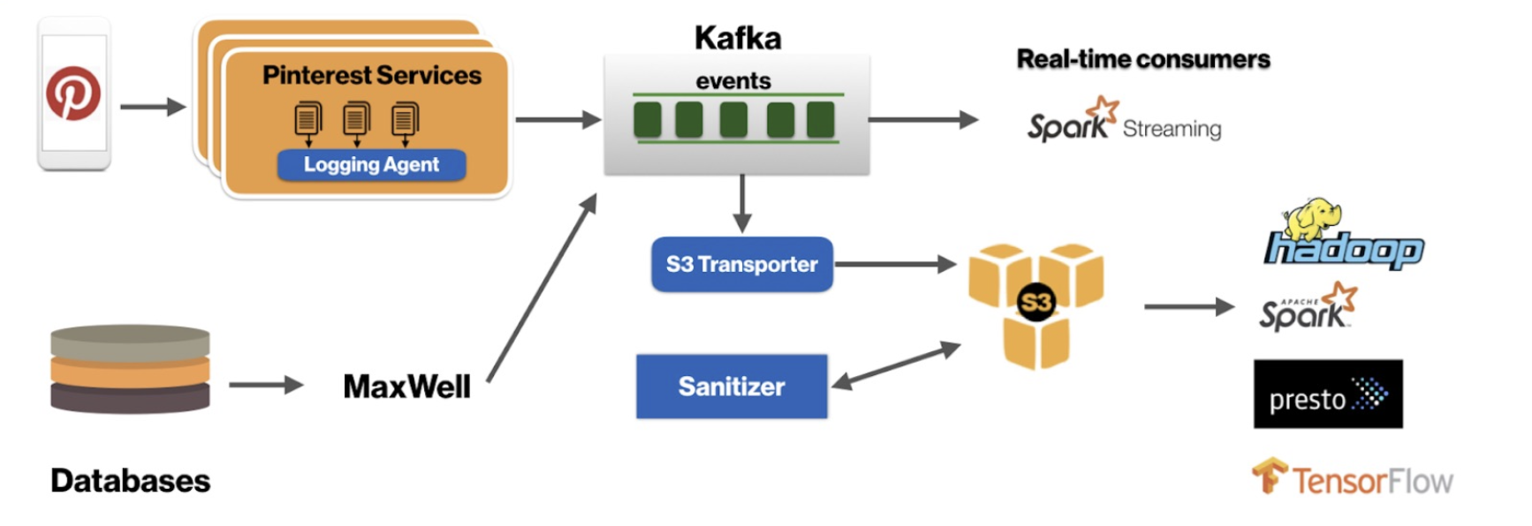
Spark Use-Cases
Recommendation systems (Netflix, Pinterest)
Fraud detection
Sentiment analysis (Twitter)

Slide 8
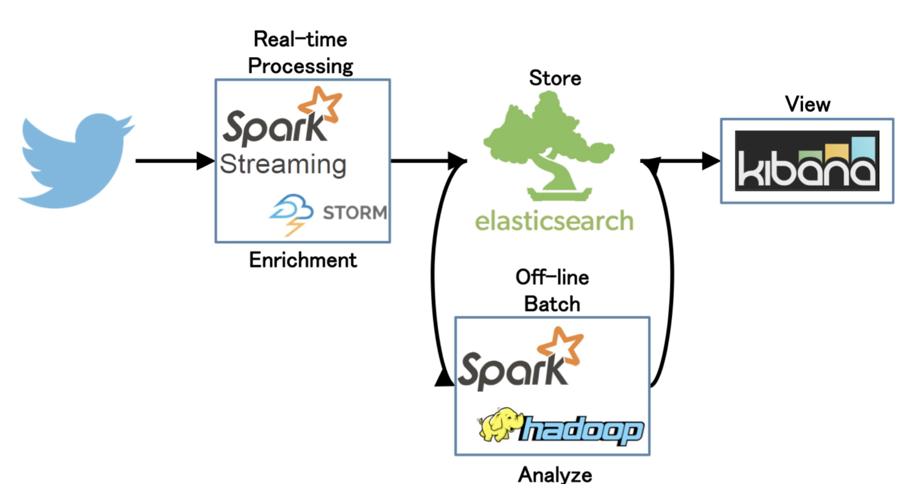
Spark Use-Cases
Sentiment analysis (Twitter)

Slide 9
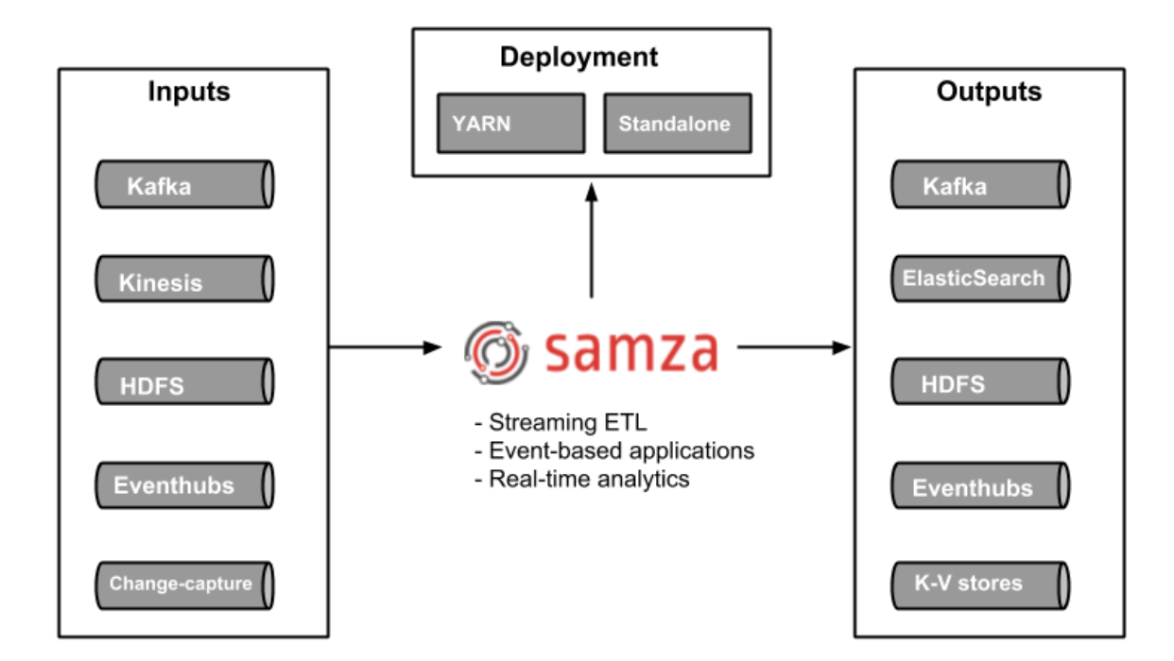
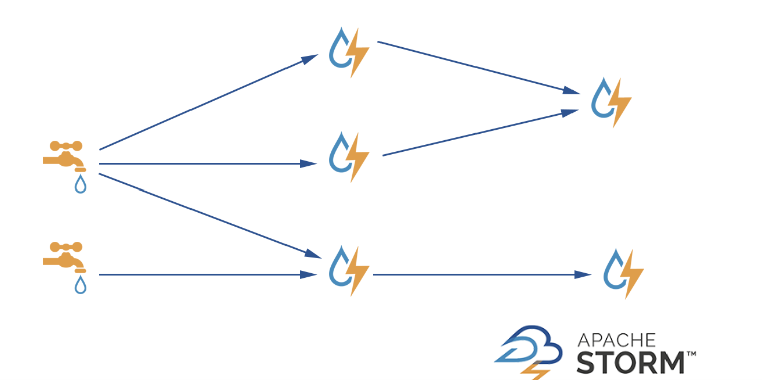
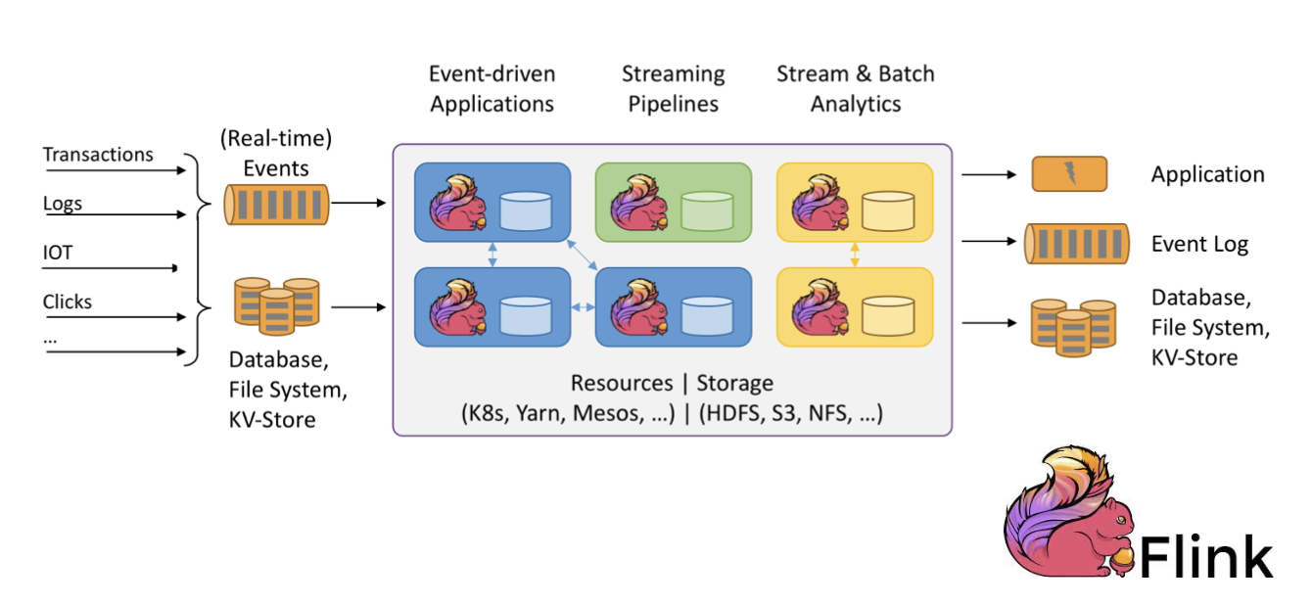
Apache Spark “real-time”
Apache Samza (library/framework)
Apache Storm (real-time stream processing)
Apache Flink (native streaming support for all workloads)

Slide 10
Apache Spark 3.x
Latest release – v3.1.1. (March 2, 2021)
Improvements over Spark 2 (v2.4.1)
▶ Python 2 deprecated
▶ Adaptive execution of Spark SQL (merging intermediate results among workers)
▶ Dynamic partition pruning
▶ Support for deep learning (GPU support for Nvidia, AMD, Intel)
▶ Better Kubernetes integration
▶ Graph features (Morpheus as extension of Cypher, neo4j support)
▶ ACID transactions (for Delta Lake storage)
▶ Apache Arrow data format integration (columnar format for analytics)

Slide 11
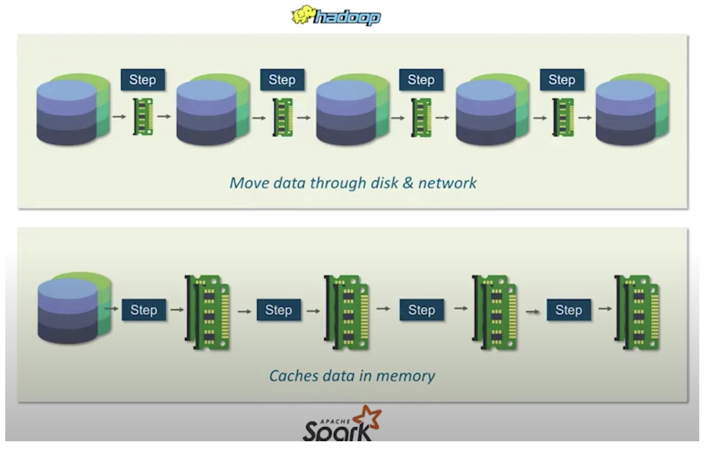
Hadoop MapReduce vs. Apache Spark
Big data frameworks
Performance
Ease of use
Costs
Data processing
Fault tolerance
Security
Hadoop
Archival data analysis
Spark
Real-time data analysis

Slide 12
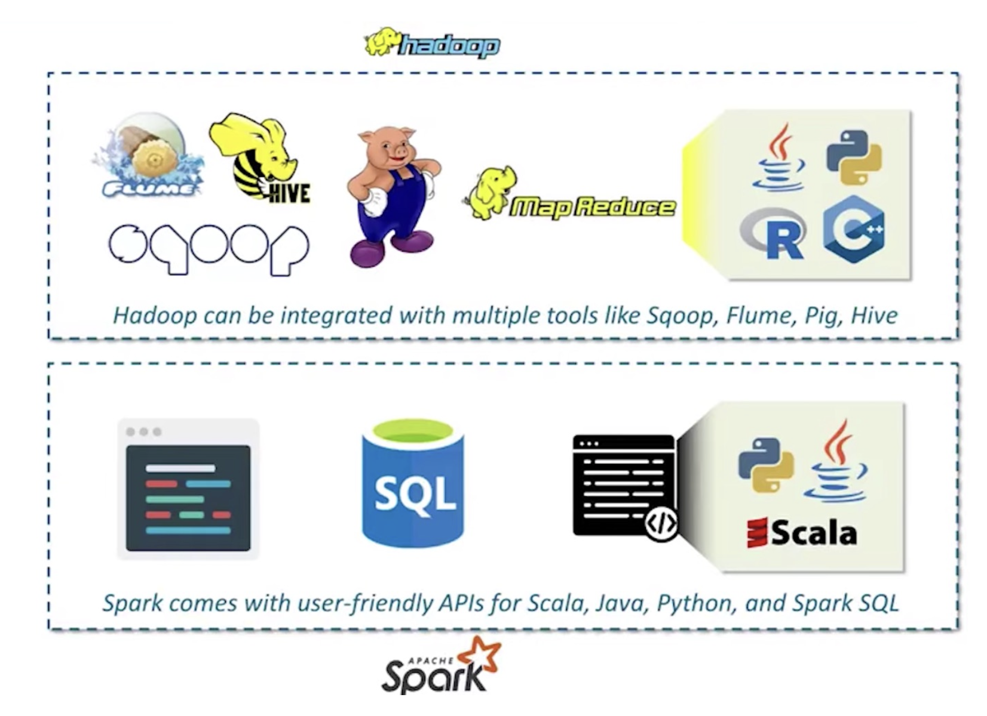
Hadoop MapReduce vs. Apache Spark

Slide 13
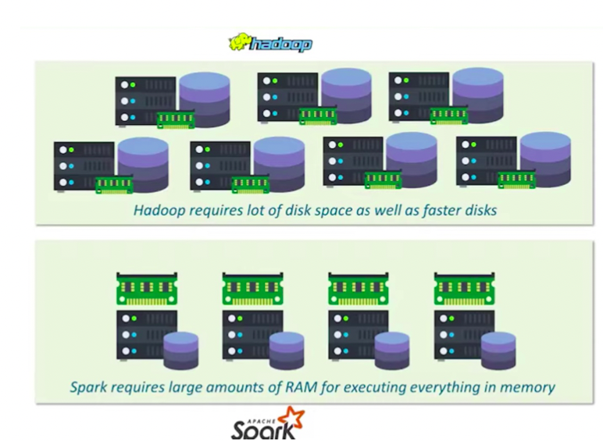
Hadoop MapReduce vs. Apache Spark

Slide 14
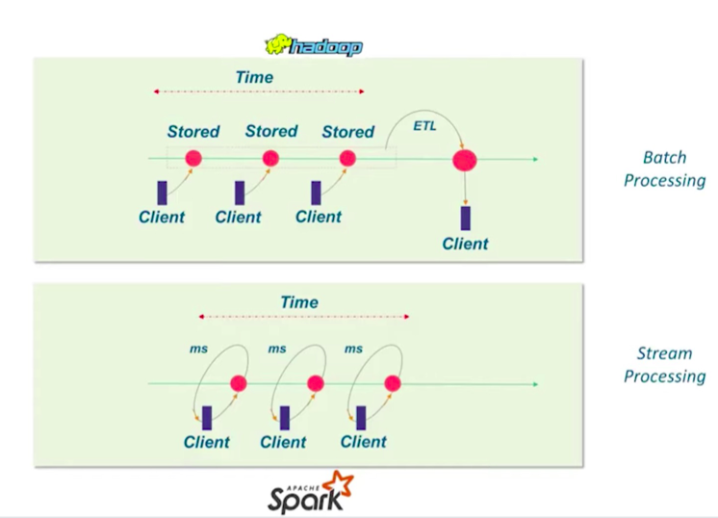
Hadoop MapReduce vs. Apache Spark

Slide 15
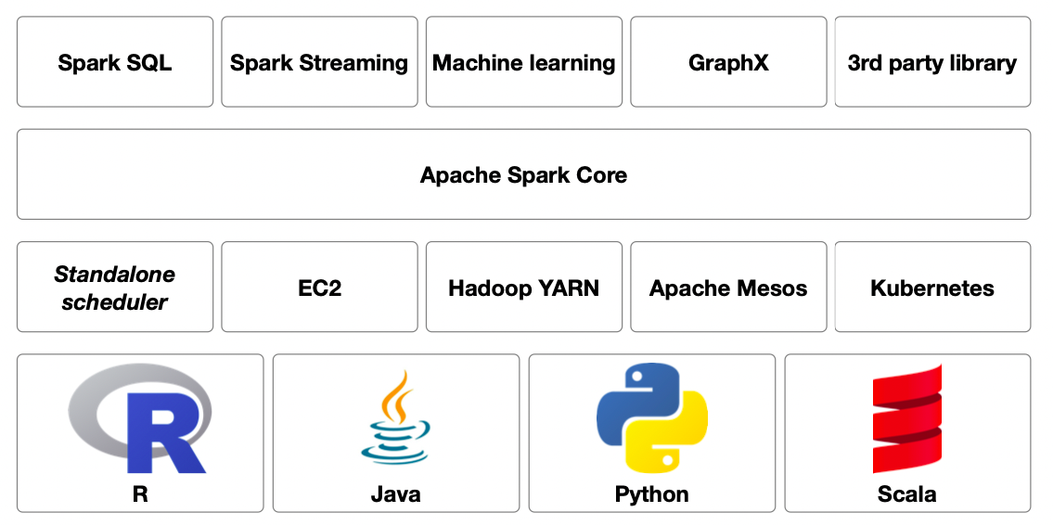
Apache Eco-System

Slide 16
Spark Core functionalities
Core functionalities
task scheduling
memory management
fault recovery
storage systems interaction
etc.
Basic data structure definitions/abstractions
Resilient Distributed Data sets (RDDs)
main Spark data structure
Directed Acyclic Graph (DAG)

Slide 17
Ecosystem: Spark SQL
Structured data manipulation
Data Frames definition
Table-like data representation
RDDs extension
Schema definition
SQL queries execution Native support for schema-based data
Hive, Paquet, JSON, CSV

Slide 18
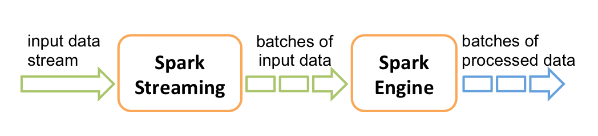
Ecosystem: Spark Streaming
Data analysis of streaming data
e.g. tweets, log messages, SCADA
Features of stream processing
High-throughput
Fault-tolerant
End-to-end
Exactly once
High-level abstraction of a discretized stream
Stream represented as a sequence of RDD
With Spark 2.3.x and above continuous processing
End-to-end low latency (< 1ms)

Slide 19
Ecosystem: Spark MLlib for Machine Learning
Common ML functionalities
ML Algorithms
▶
▶
▶ common learning algorithms such as classification, regression, clustering, and collaborative filtering ▶ Featurization
▶ feature extraction, transformation, dimensionality reduction, and selection ▶ Pipelines
▶ tools for constructing, evaluating, and tuning ML Pipelines ▶ Persistence
▶ saving and load algorithms, models, and Pipelines ▶ Utilities
▶ linear algebra, statistics, data handling, etc. Two APIs
▶ RDD-based API (spark.mllib package)
▶ Spark 2.0+, DataFrame-based API (spark.ml package) Methods scale out across the cluster by default

Slide 20
Ecosystem: GraphX
Support for graphs and graph-parallel computation
Extension of RDDs (Graph)
Direct multigraph with properties on vertices and edges
Graph computation operators
subgraph, joinVertices, and aggregateMessages, etc.
PregelAPI support

Slide 22
Module 2

Slide 23
Module 2
Basic Spark data structures (RDDs)
RDDs and operations
RDD transformation and RDD actions
Creating DataFrames
Creating DataSets
Organizing raw Data
Working with Spark API
Spark DataFrame API
Structured API (SQL)

Slide 24
Module 3
Designing and building pipelines, moving data and data models with Spark

Slide 25
Module 3
Data Pipelines and ETL/ELT
ETL Query
Data Source support
Schema inference
Data Quality
Transformation
Python for ETL and performance
Moving and copying data
Creating data models

Slide 26
What is pipeline
Data pipelines are set of instructions for data movement from source to sink. It is commonly known in data science community and also between data engineers for ETL or ELT.
Pipeline is understood as a:
sequence of transformations on data
Source data is typically semi-structured/unstructured (JSON, CSV etc.) and structured (JDBC, Parquet, ORC, the other Hive-serde tables)
Output data is integrated, structured and curated.
Data at the end of the pipeline is ready for further data processing, analysis and reporting.

Slide 27
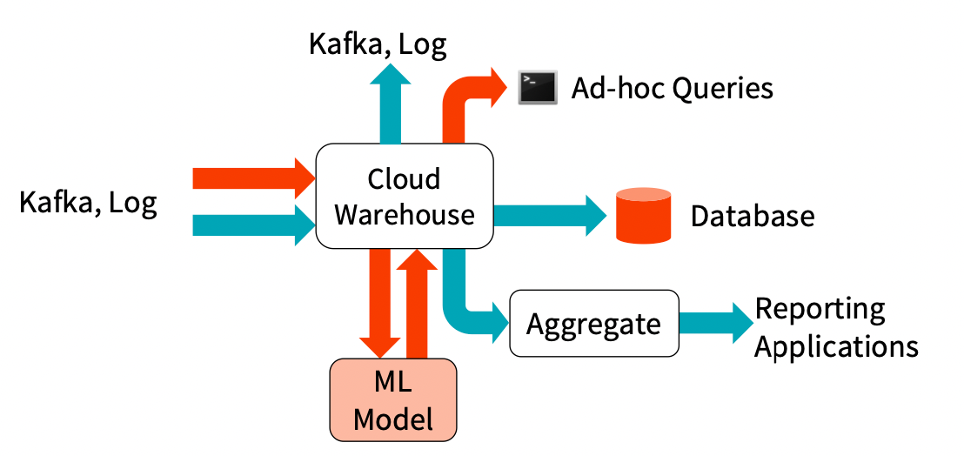
Daily scenario of data pipeline
Sequence of transformation on data
Source: semi-structured/unstructured (JSON, CSV etc.) and structured (JDBC, Parquet, ORC, the other Hive-serve tables)
Sink: Data is integrated, structured and curated and ready for consumption.

Slide 28
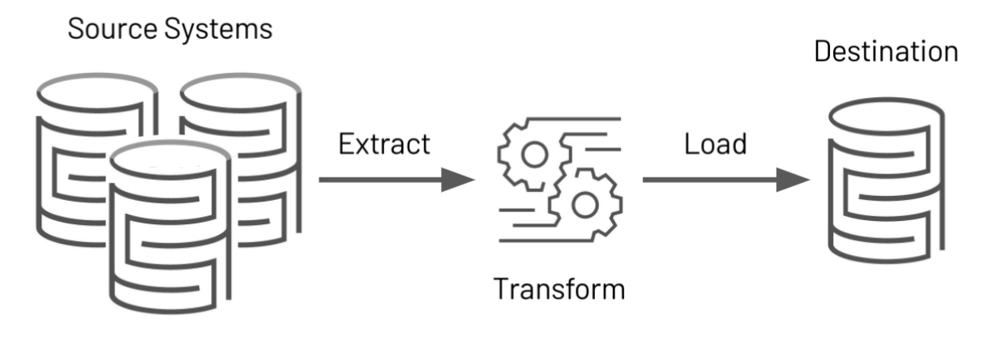
ETL is the first Step in a Data Pipeline
Goal: is to clean or curate the data.
Retrieve data from sources (EXTRACT)
Transform data into a consumable format (TRANSFORM)
Transmit data to downstream consumers (LOAD)

Slide 29
An ETL Query in Spark
spark.read.json("/source/path")
.filter(...)
.agg(...)
.write.mode("append")
.parquet("/output/path")
EXTRACT
TRANSFORM
LOAD

Slide 30
An ETL Query in Spark
val csvTable = spark.read.csv("/source/path")
val jdbcTable = spark.read.format("jdbc")
.option("url", "jdbc:postgresql:...")
.option("dbtable", "DBO. SALES")
.load()
csvTable .join(jdbcTable, Seq("shop_id"), "inner")
.filter("region_id <= 14") .write .mode("overwrite") .format("parquet") .saveAsTable("outputTableName")
EXTRACT
TRANSFORM
LOAD

Slide 31
Why is ETL process important!
Why is ETL process hard?
Matching different schemas
Matching different data types
Checking for data issues (corrupt files)
Checking for changes in schema
Scalability
Continuous ETL and ELT
Checking for data issues (corrupt files)

Slide 32
ETL must have and must be!
Error-prone
Fully Logged
ACID “in all aspects”
Always “fast” and never “too slow”
Cheap and low maintenance
Never ”too complex” and easy to “scale”
Fully documented

Slide 33
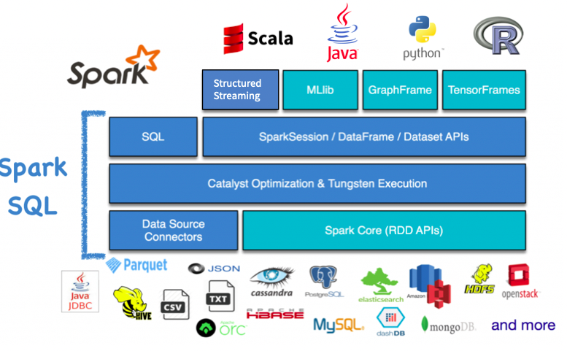
This is why ETL is important
Nobody wants messy and complex data ☺
Spark SQL's flexible APIs, support for a wide variety of datasources, build-in support for structured streaming, state of art catalyst optimizer and tungsten execution engine make it a great framework for building end-to-end ETL pipelines.

Slide 34
Data Source Supports
Built-in connectors in Spark:
– JSON, CSV, Text, Hive, Parquet, ORC, JDBC
Third-party data source connectors:
– https://spark-packages.org
Define your own data source connectors by Data Source APIs – Ref link: https://youtu.be/uxuLRiNoDio

